Slide 1
Frontend Development
component-based frameworks

Slide 2
plan
Front end development
Components
State
Compilation
Styling
Responding to events
Vue

Slide 3
Introduction

Slide 4
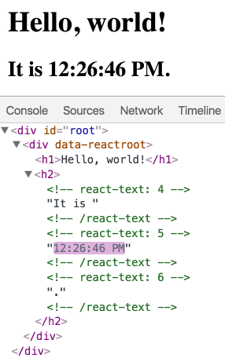
Virtual DOM
The virtual DOM (VDOM) is a programming concept where an ideal, or “virtual”, representation of a UI is kept in memory and synced with the “real” DOM by a library. This process is called reconciliation.
You tell the framework what state you want the UI to be in, and it makes sure the DOM matches that state.
This abstracts out the attribute manipulation, event handling, and manual DOM updating that you would otherwise have to use to build your app.
Notes:
From reactjs.org

Slide 5

declarative coding
React adds declarative extensions to JavaScript and HTML
These let you describe what you want in the UI not how it is going to be made
Code is (typically) written in JSX
Compiled to JavaScript
Can be nested
Can contain raw JavaScript
Prevents Injection Attacks
React doesn’t require using JSX, but most people find it helpful as a visual aid when working with UI inside the JavaScript code. It also allows React to show more useful error and warning messages
Notes:
https://www.youtube.com/watch?v=x7cQ3mrcKaY

Slide 6
why do we need these frameworks
Most developers building complex Web applications now use React, Vue, express etc.
But the Web is essentially simple
Text files structured in HTML
JavaScript, CSS flavourings
We know that having reusable components makes for better software
Re-use of code through parameterization
Easier testing
Better support for teams
Using a framework lets us leverage the efforts of a wider community
Frameworks
Reduces time to market
Improve the quality of our products

Slide 7
Components

Slide 8
elements
React applications create elements that are rendered in the DOM
Elements are immutable
Changes of state cause elements and their children to be re-rendered
The react library manages how and when this is done
Only those DOM elements that need to be re-rendered are
React developers
Should think about how the page looks in each state
Should not think about how the page is going to change

Slide 9
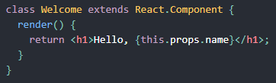

what are components
Components are reusable, independent pieces of code that are rendered as UI elements
Take data and produce HTML
Think of components as being JavaScript functions
They have unique names
They can receive arguments
These are called properties (props)
The return react elements that can be rendered in the page
Components are defined using either
Functions - most often
ECMA-6 style classes - only when you need state

Slide 10
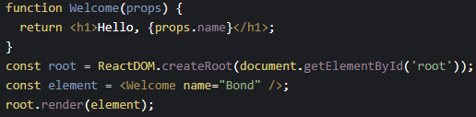
functions
Most components should be created using this approach
They have properties but not state
They can be part of a hierarchical tree of components
Using them is easy
Although they can be written in JavaScript it is better/easier/idiomatic to use JSX
They have a render() method that is used to build and return HTML
Data can be passed into the component and accessed in the render() method
It is held in a JavaScript object that is called props
Access the data using {props.xyz}
Inside curly braces
Where xyz is replaced by the name of the property

Slide 11
functions
function Welcome(props) {
return <h1>Hello, {props.name}</h1>;
}
function App() {
return (
<div>
<Welcome name="Sara" />
<Welcome name="Bond" />
<Welcome name="Groot" />
</div>
);
}
const root = ReactDOM.createRoot(document.getElementById('root'));
root.render(<App />);

Slide 12
React

Slide 13
what is React
React is a JavaScript library for building user interfaces
Originated by Facebook
Now developed by Facebook and a wide community
React makes it easy to build single-page applications
Download one HTML page
Have the things on it interact
With each other
With servers and services
Usage
Use React with "create react app", Next.js or with Gatsby.
Timeline
Open sourced in 2013
React Native released in 2015

Slide 14
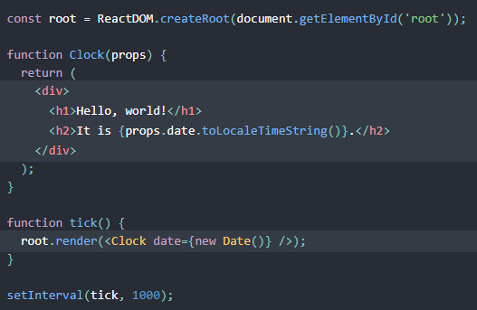
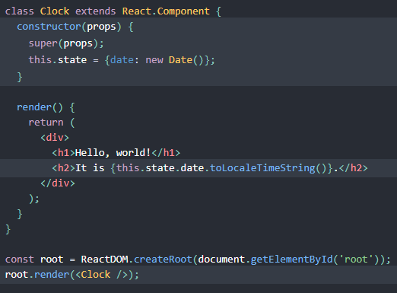
Functions v Classes

Slide 15
classes
If we want to manage state, then we should use a class-based component
They have a constructor
Accepts a properties object
Must call the superclass constructor as its first action
Like function-based components these also have
props
render() methods
The state is held in an object called this.state
These classes can respond to a number of lifecycle events
componentDidMount
componentWillUnmount

Slide 16
classes
Managing state
You cannot manipulate state directly
this.state.comment = 'Hello'; is incorrect
Updates to state:
Are managed by the React framework
May be asynchronous and (often) batched
Manipulate state this way
this.setState({comment: 'Hello'});
Note pass in either
A list of name:value pairs
A function

Slide 17
state vs props
Use props for values that you will not change
Use state only for things that have to be mutated in the component
Mutation typically occurs in response to
User-generated events
Input into a text box
Mouse clicks
etc.
System-generated events
Web Sockets
State is private
Components should not manipulate the state of their children

Slide 18
applications

Slide 19
compilation and build
React applications are written using a language called JSX
It is an extension to JavaScript
You can use raw JavaScript, but JSX is better integrated into the toolchain
React is an opinionated framework
Logic and UI rendering are integrated
Separation of concerns simplifies development
Implemented through components
Use semicolons for readability
React JSX uses camelCase to separate its DOM from the HTML DOM
Yes, react has a virtual DOM of its own to help with compilation and build

Slide 20
compilation and build
React compile JSX into JavaScript
class Hello extends React.Component { render() { return <div>Hello {this.props.toWhat}</div>; } }
Becomes
class Hello extends React.Component { render() { return React.createElement('div', null, `Hello ${this.props.toWhat}`); } }
Which makes runtime calls into the react framework

Slide 21
styling
The look and feel is controlled by CSS
You could use a single, global stylesheet
But components are local objects
Is this readily scalable?
The tendency is to use a separate stylesheet for each component
Put the component’s source code in a folder
Put a small stylesheet in the same folder
You must use the className property to identify the style

Slide 22
Events

Slide 23
lifecycle
Components have a 4-stage lifecycle
Mounting
When the component first loads
Construction
Rendering
Updating
When props or state change
Re-rendering
Unmounting
The component is removed from the DOM
Error handling
Called if there is problem loading or rendering

Slide 24
responding to events
componentDidMount()
Called as soon as the component is added to the DOM
Put requests to remote APIs and endpoints here
Calling setState() immediately will trigger a render before the browser displays the component
componentDidUpdate()
Called after an update
Requests that change state (eg to a remote server) need to compare their result with props
componentWillUnmount()
Invoked before the component is unmounted and destroyed
Use this to clean up ongoing requests, open connections etc.
Do not call setState() in here as it will not re-render

Slide 25
Vue

Slide 26
Introduction: Vue
The Vue project was started in 2013 by its founder, Evan You.
In 2014 version one launched and started to become popular in China

Slide 27
Vue
Vue uses Single-File Component (SFC).
An SFC is a reusable self-contained block of code that encapsulates HTML, CSS and JavaScript that belong together, written inside a ".vue" file.
Like React, the core feature of Vue is declarative rendering:
Using a template syntax that extends HTML, describe how the HTML should look like based on JavaScript state.
When the state changes, the HTML updates automatically

Slide 28
Directives
Vue.js directives are HTML attributes with the prefix v-
Example
v-bind (<img v-bind:src="">)
v-model
v-if/v-else-if/v-else

Slide 29
Events
We can use the v-on directive, (shortened to the @ symbol) to listen to DOM events and run some JavaScript when they are triggered.
v-on:click="handler" or @click="handler"
Where "handler" -> Inline handler: Inline JavaScript to be executed when the event is triggered.
Method handler: A property name or path that points to a method defined on the component.

Slide 30
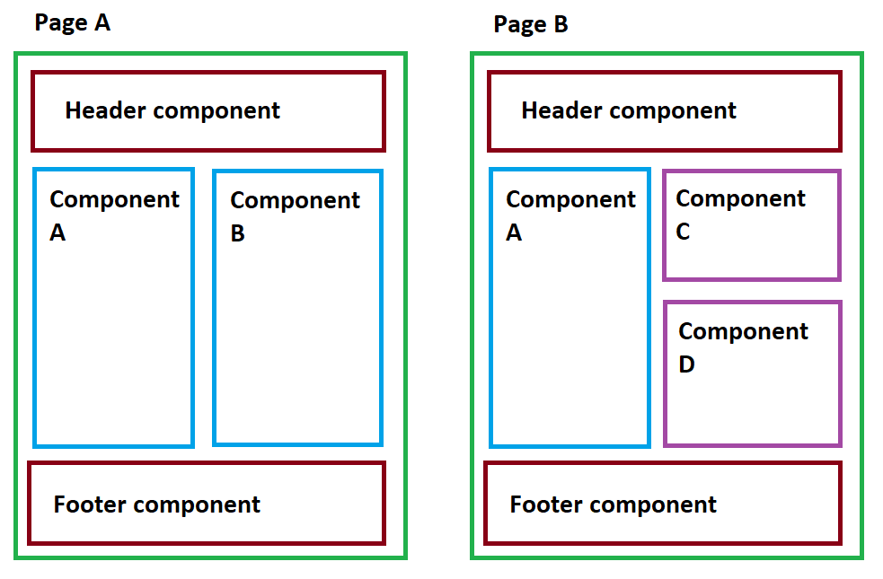
Components
A parent component can render another component in its template as a child component
Components include logic for state, data and styles for the component.
It also includes a template for markup

Slide 31
Creating an application
You can create an application using the Vue CLI
Walkthrough

